Slide 1
CSCA 5622 Introduction to Machine Learning:Supervised Learning
Default of Credit Card Clients

Slide 2
Purpose
The purpose of Default of Credit Card Client kaggle project is to build a supervised Machine learning model that predicts whether a credit card client will default on their payment in the next month.
This is a binary classification problem based on real world financial and demographic data from clients in Taiwan, collected between April and Sept 2005.
Multiple algorithms like Logistic Regression,Random Forest Classifier,XGBoost and SVC were trained and evaluated.

Slide 3
Data Source Citation
1.UCI Machine Learning Repository:
Yeh, I. (2009). Default of Credit Card Clients [Dataset]. UCI Machine Learning Repository. https://doi.org/10.24432/C55S3H.
2.Kaggle Platform:
The dataset was accessed from the Kaggle platform:
Default of Credit Card Clients Dataset. (n.d.). Www.kaggle.com. https://www.kaggle.com/datasets/uciml/default-of-credit-card-clients-dat

Slide 4
Data Source
Data Size:
Number of rows: 30,000
Number of features: 25
Data Types:
3 Categorical features and the remaining Numerical features.
Education
Sex
Marriage

Slide 5
Data Cleaning
The dataset contains 3 categorical variables: Education,Sex and Marriage
Rare or undefined values in Education([0,5,6]) were grouped under category 4,and Marriage value 0 was reassigned to 3(“Others”)
The column PAY_0 was renamed to PAY_1for consistency with other payment status features.
The dataset contains no missing values or duplicate entries,ensuring data integrity.
A significant class imbalance exists,with the majority of samples belonging to class 0(non-default).Techniques such as resampling or SMOTE may be applied to address this imbalance.

Slide 6
Exploratory Data Analysis
Categorical Feature Distributions:The three categorical variables—EDUCATION, MARRIAGE, and SEX—were analyzed and visualized to understand their relationship with default status.
Gender vs. Default Status:Although females make up 60% of the dataset, males show a higher default rate (24% of all males). Class 0 (non-default) dominates both genders due to class imbalance.
Education Levels:Most clients, both defaulters and non-defaulters, belong to the Graduate School and University categories. Other education levels contribute minimally, likely due to sparse data.

Slide 7
Exploratory Data Analysis(Contd.)
Marriage Status: Defaulters are primarily found in the 'Single' and 'Married' groups.
Age Distribution: Age was binned for visualization; clients in their 20s show the highest default rate, possibly due to limited savings.
Correlation Insights: LIMIT_BAL and PAY_1 show strong correlation with default status, indicating their predictive importance.
Compute Variance Inflation factor to check Multicollinearity
Check Outliers by Credit Limit
Credit Limit Patterns: Non-defaulters tend to have higher and more flexible credit limits; defaulters are assigned lower limits, reflecting risk-based credit allocation.
Perform Statistical Tests like chi square tests(Categorical columns) and Anova Test (Numerical columns)
Kde plot on the strongest predictor

Slide 8
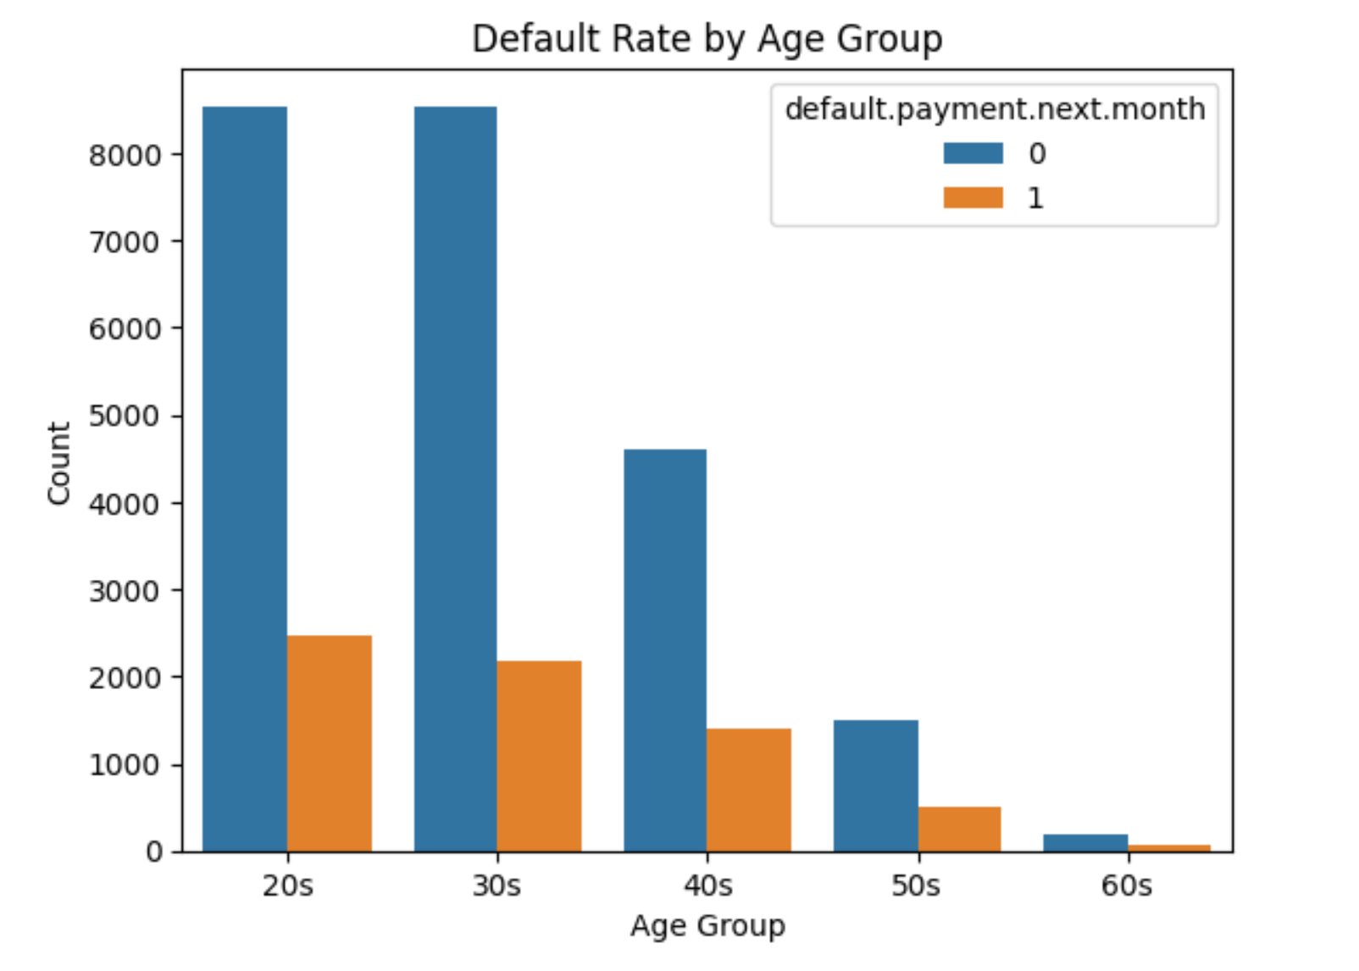
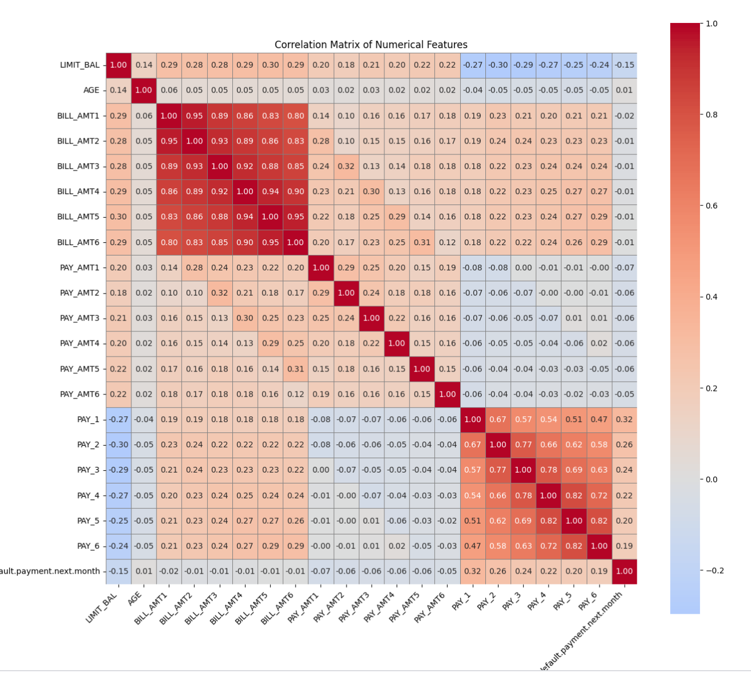
Exploratory Data Analysis(Contd.)

Slide 9
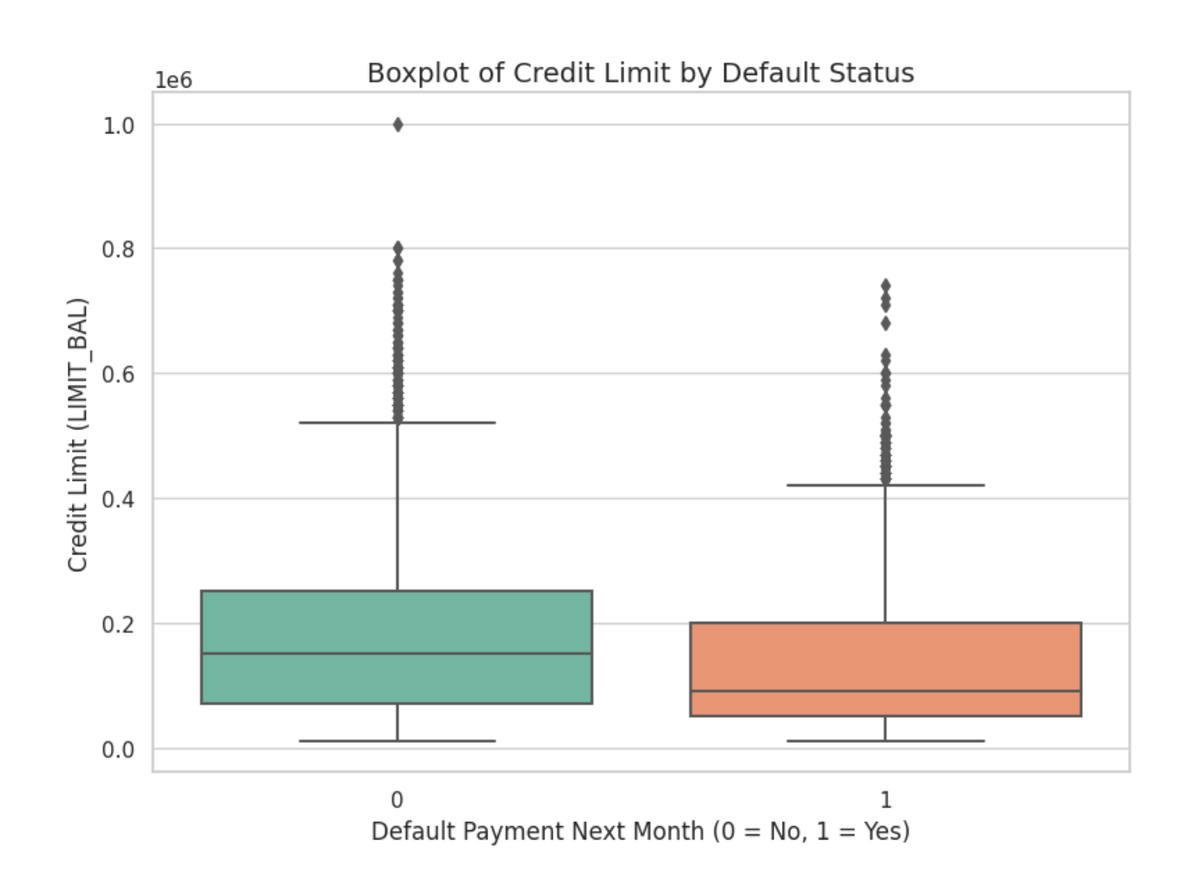
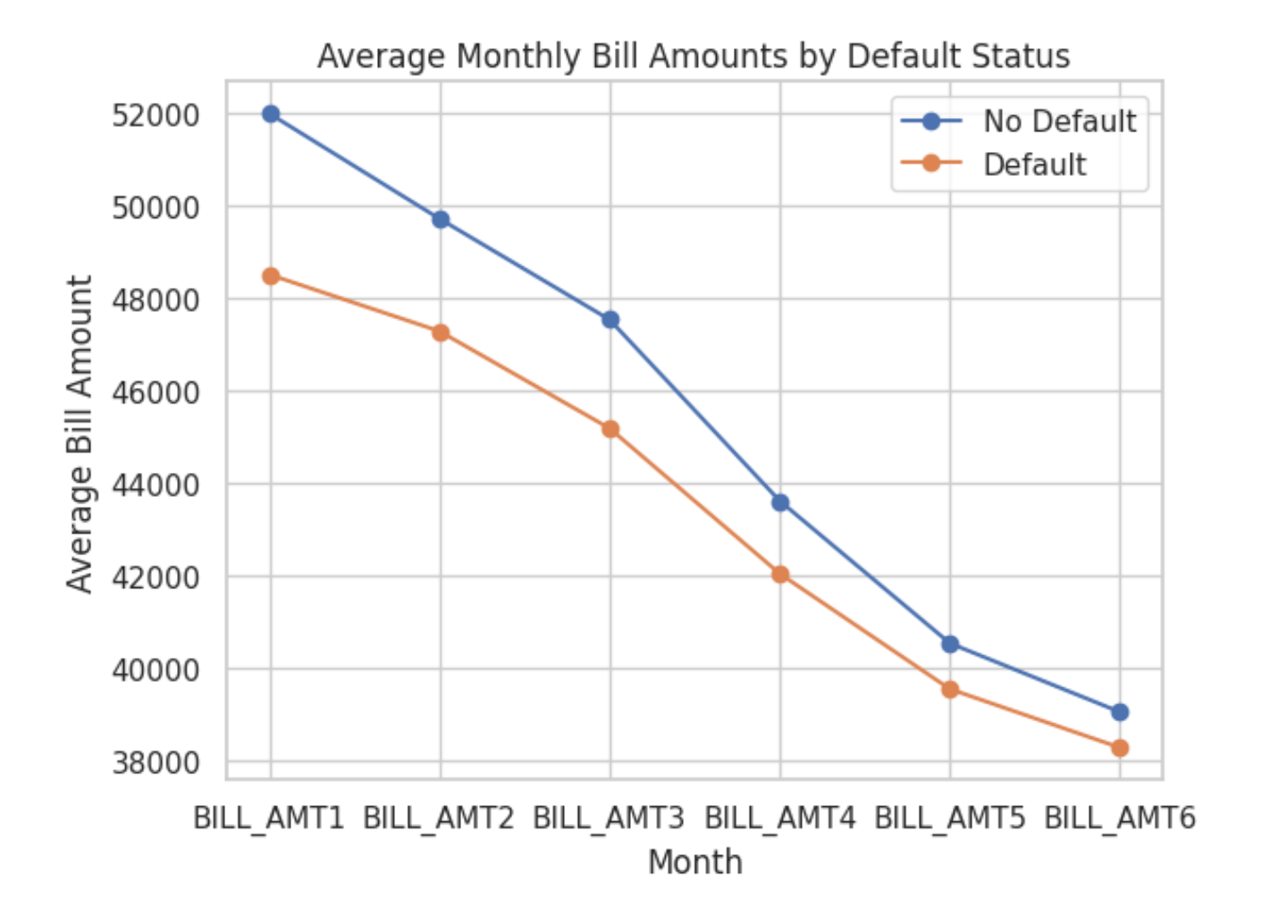
Exploratory Data Analysis(Contd.)

Slide 10
ML PipeLine
Data Preprocessing
Separate Features & Target and Train/Test/Validation Split
Feature Selection and Scaling
Handle Class Imbalance
Model Training and Evaluation
Model Performance Summary
Implementing the best model on Testset
Conclusion

Slide 11
Model Training and Evaluation
Default Credit Card Clients project has been trained on the following 4 Supervised learning algorithms:
Logistic Regression
Random Forest Classifier
XGBoost
SVC

Slide 12
Model Optimization Summary
Applied hyperparameter tuning to each model using GridSearch/Randomized CV to identify optimal settings.
Select the best threshold value for classification and recalculated accuracy.
Preformed Cross-validation on each model to compute the mean F1 score ensuring robust performance evaluation.
Compared tuned models against baseline versions to assess improvements in recall,F1 score and ROC-AUC.
Visualized performance metrics to support final model selection.

Slide 13
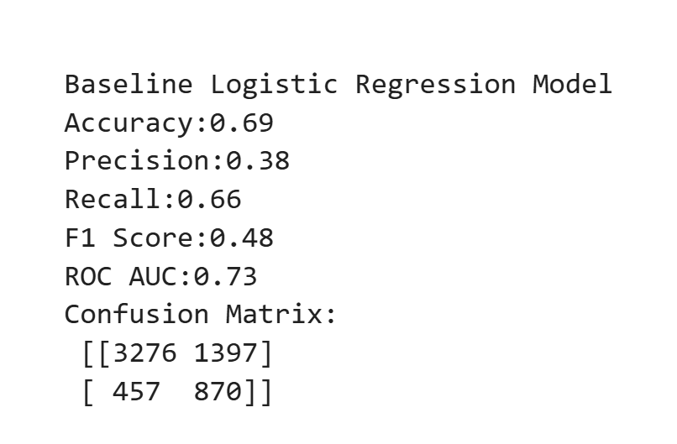
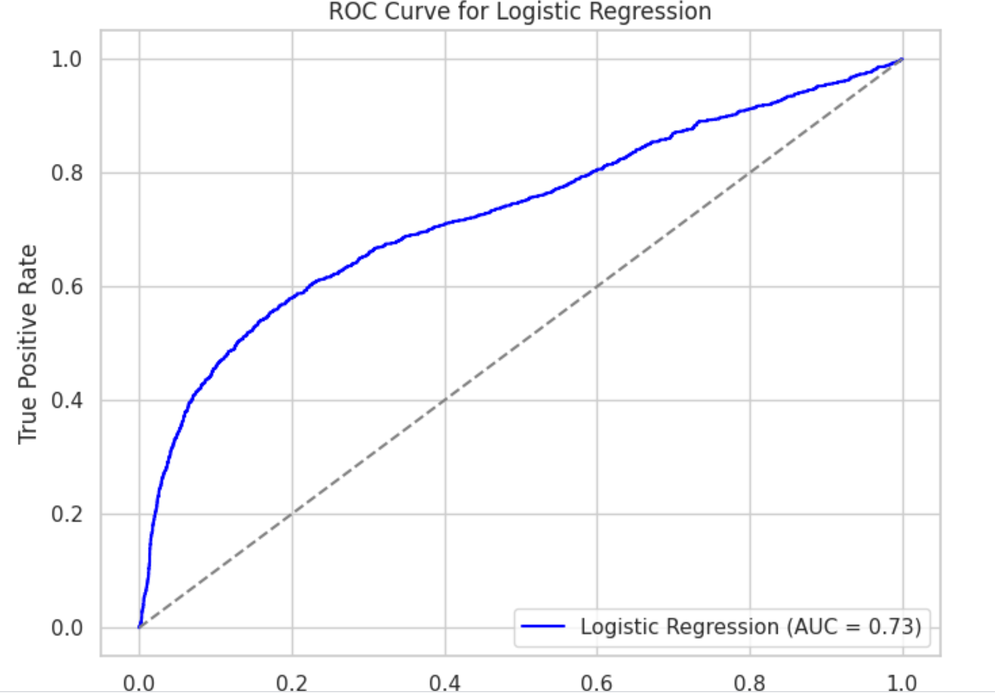
Logistic Regression(Baseline Model)

Slide 14
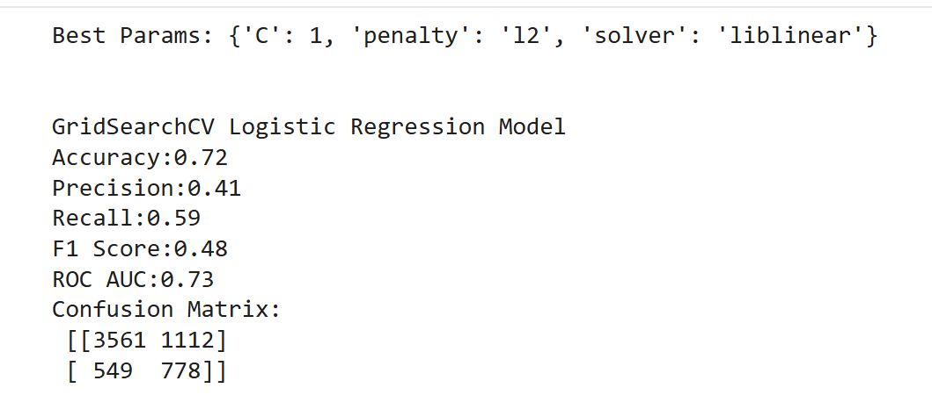
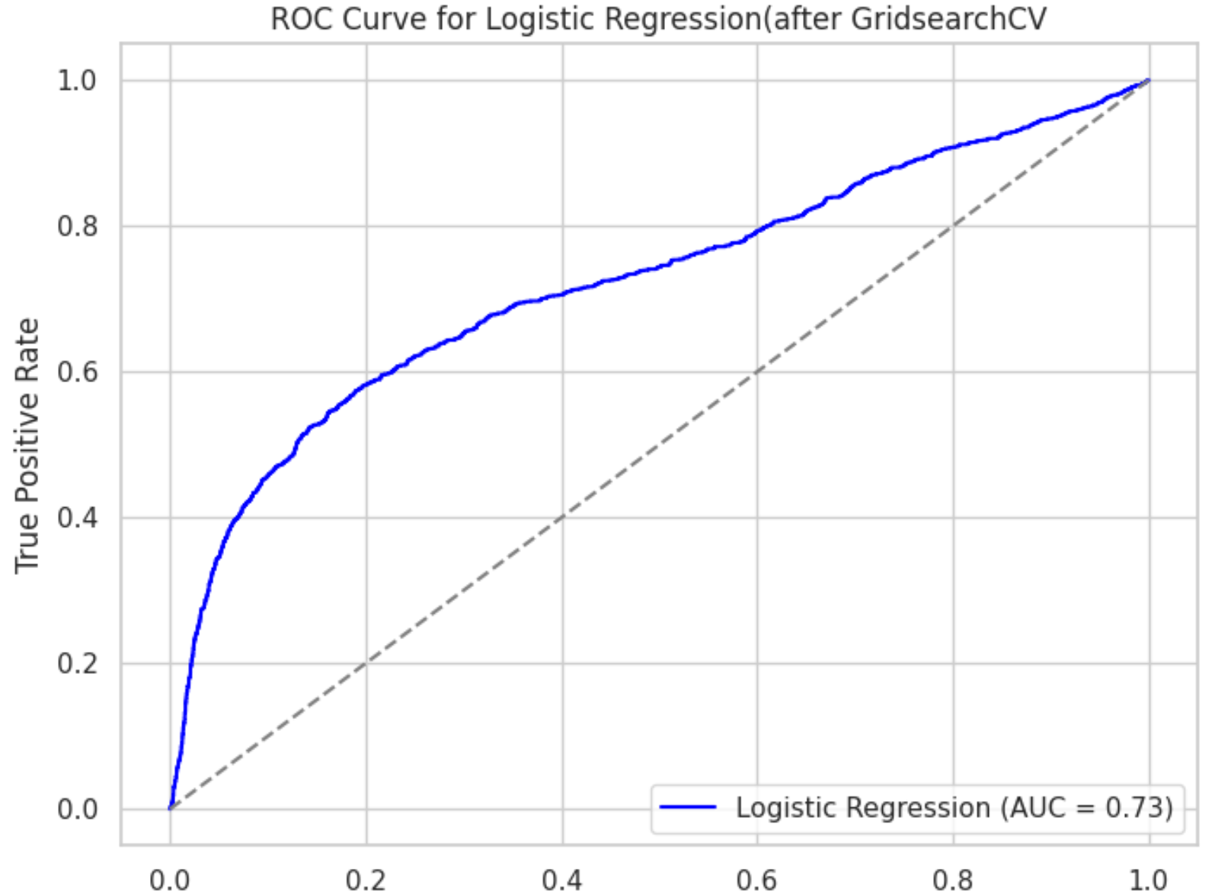
Logistic Regression (HyperTuned Model)

Slide 15
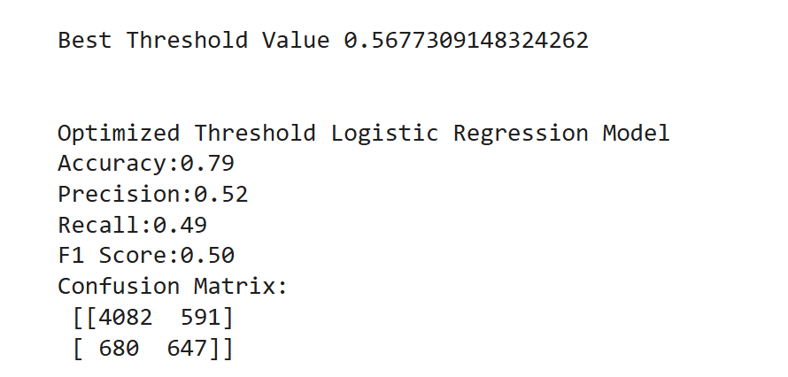
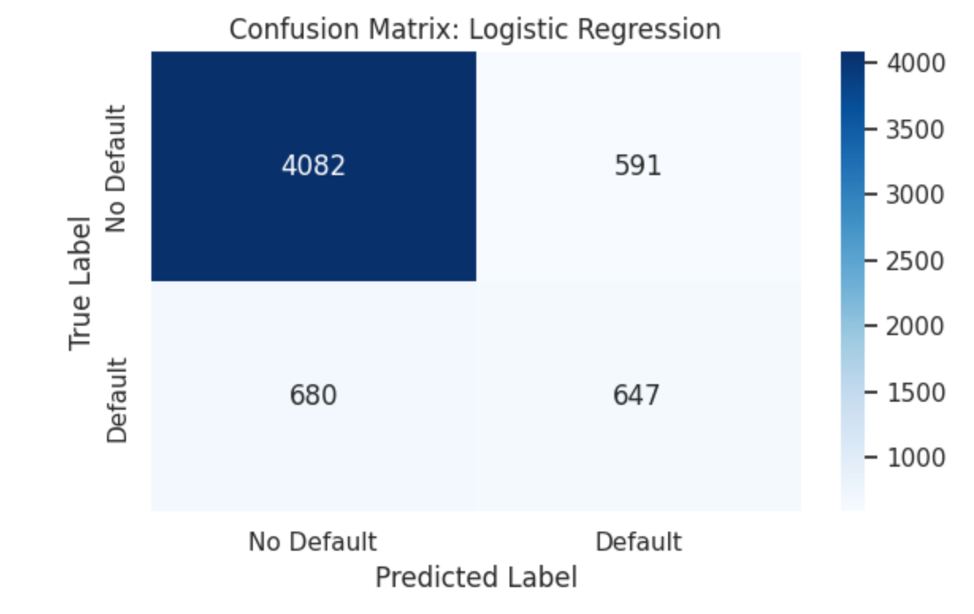
Logistic Regression(Best Threshold)

Slide 16
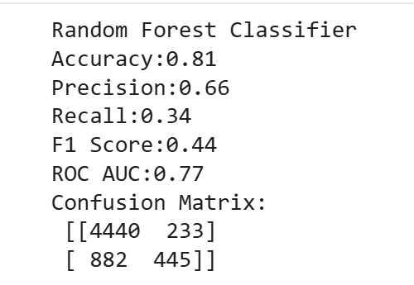
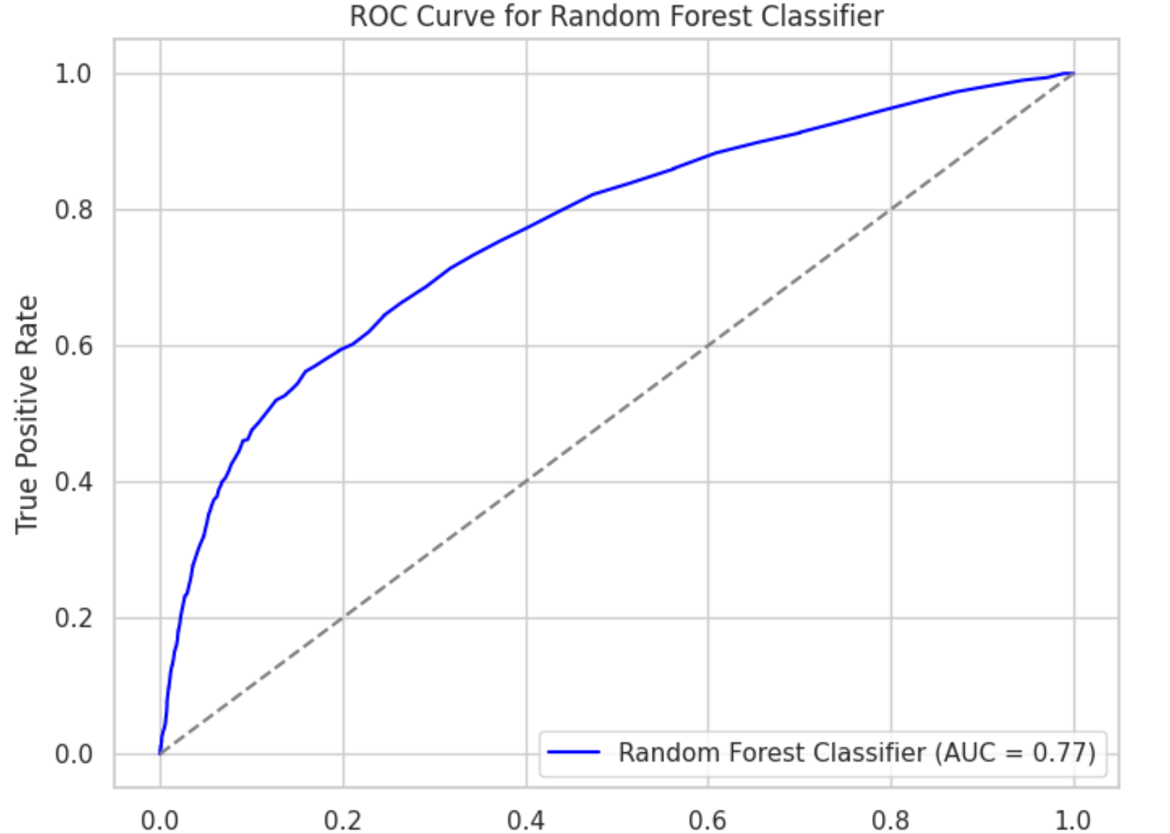
Random Forest Classifier(Baseline Model)

Slide 17
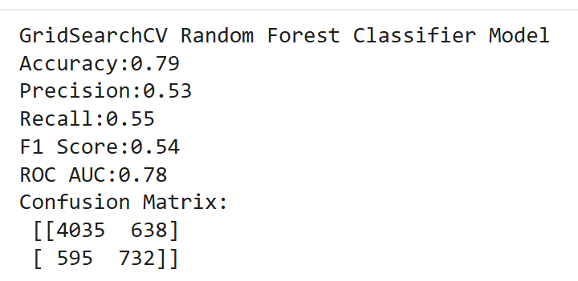
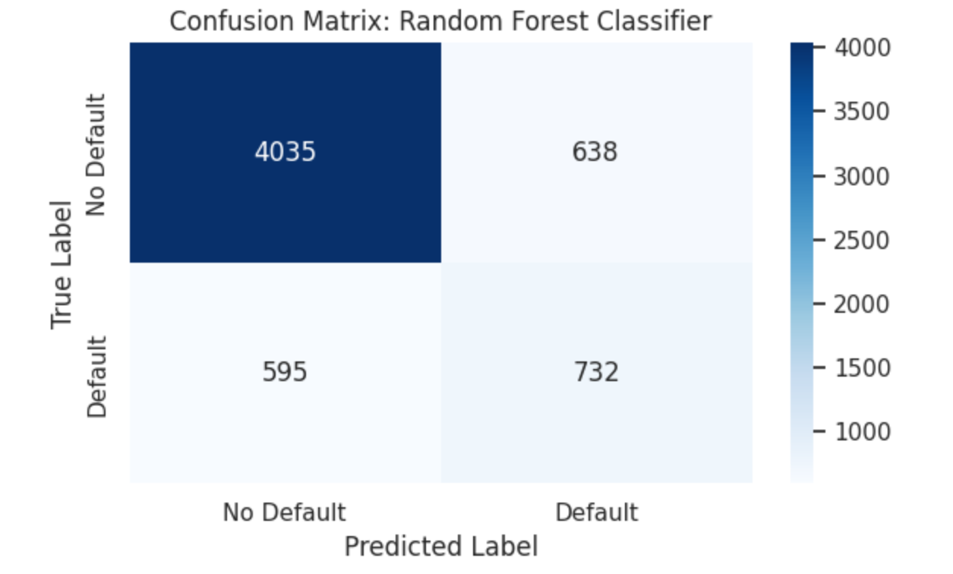
Random Forest Classifier(HyperTuned Model)

Slide 18
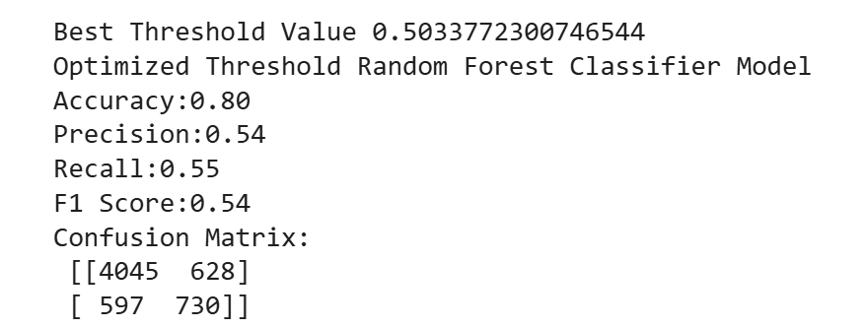
Random Forest Classifier(Best Threshold)

Slide 19
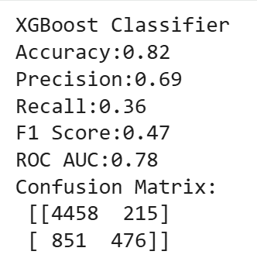
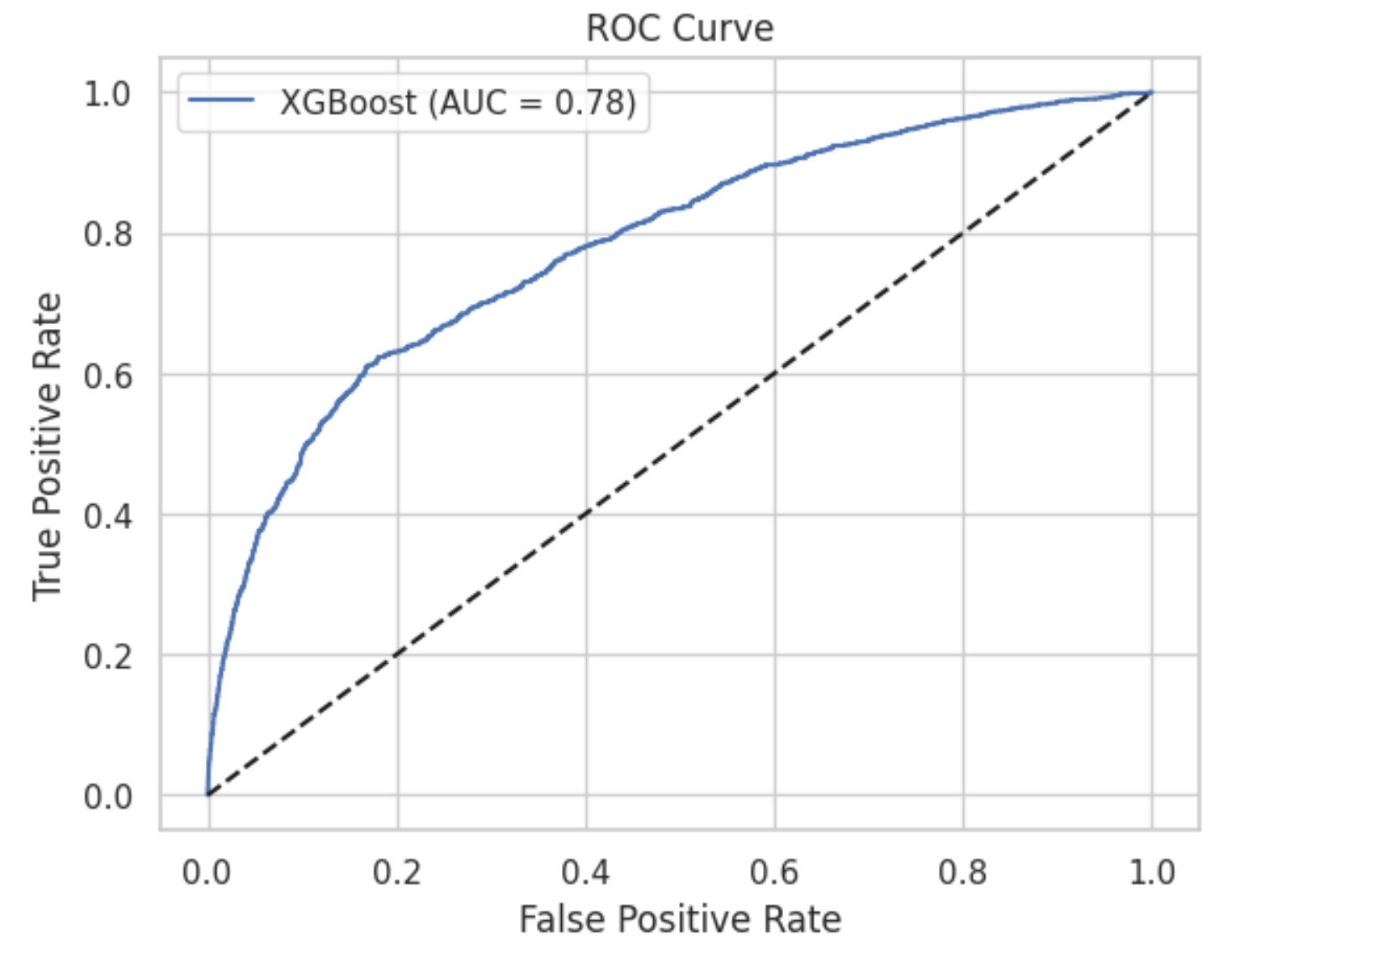
XGBoost (Baseline Model)

Slide 20
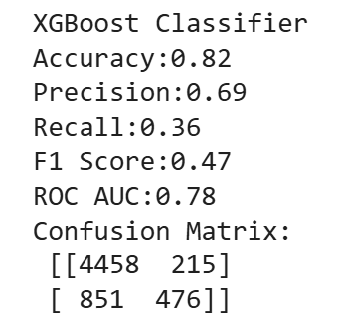
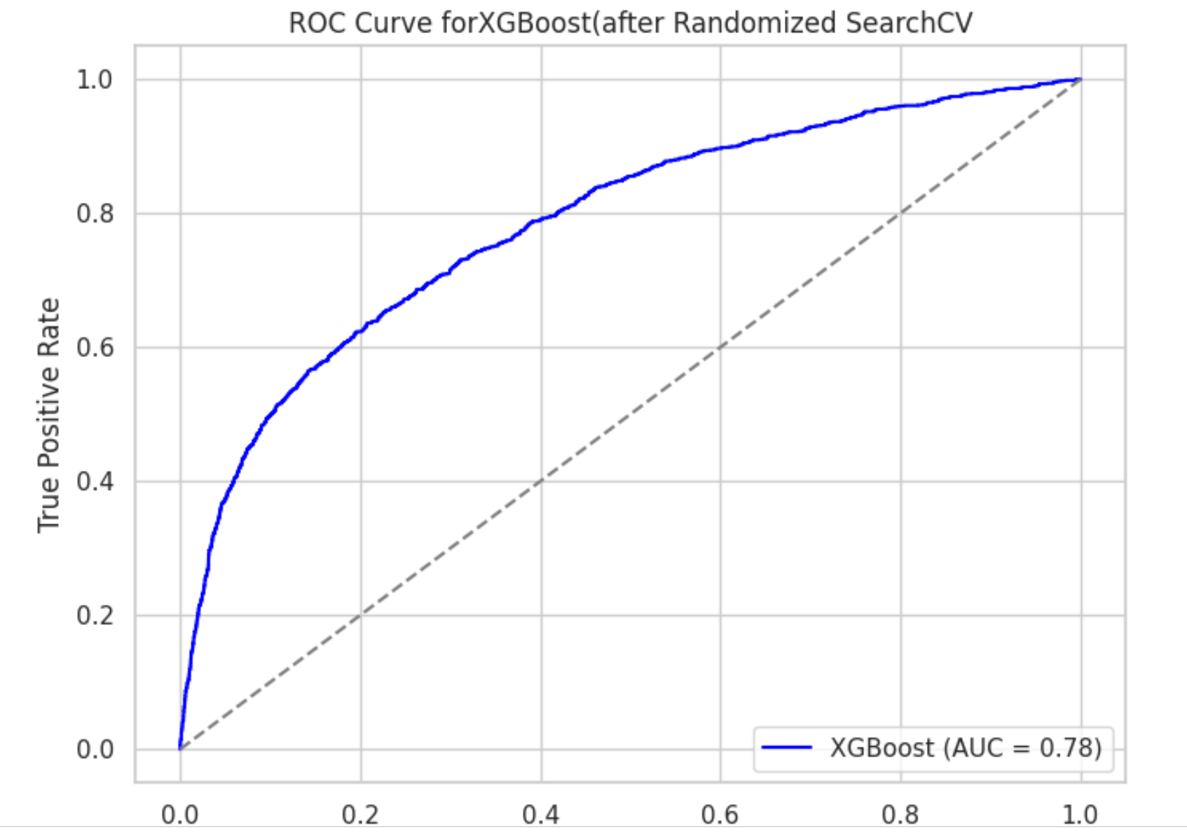
XGBoost (HyperTuned Model)

Slide 21
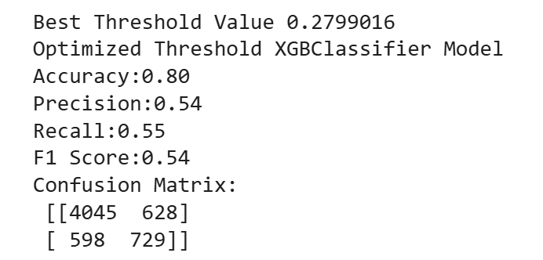
XGBoost (Best Threshold)

Slide 22
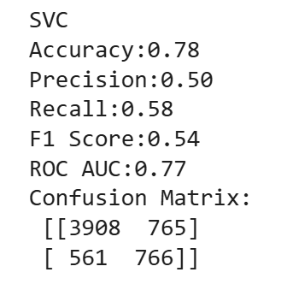
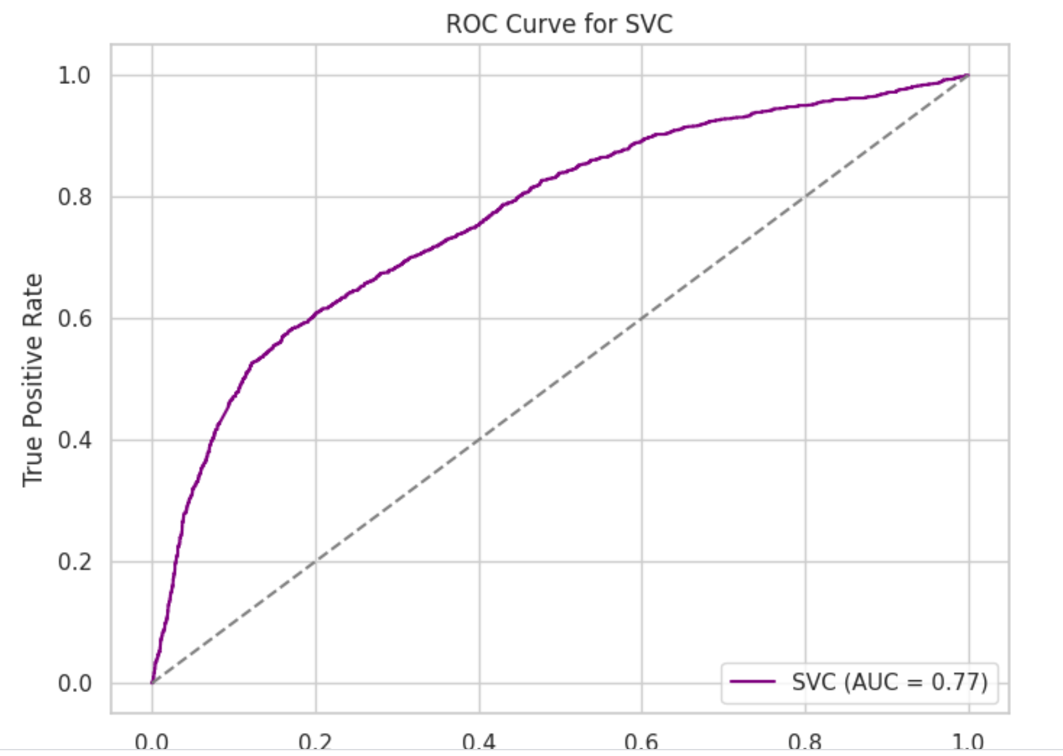
SVC(Baseline Model)

Slide 23
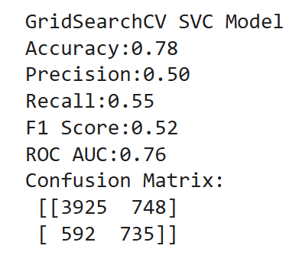
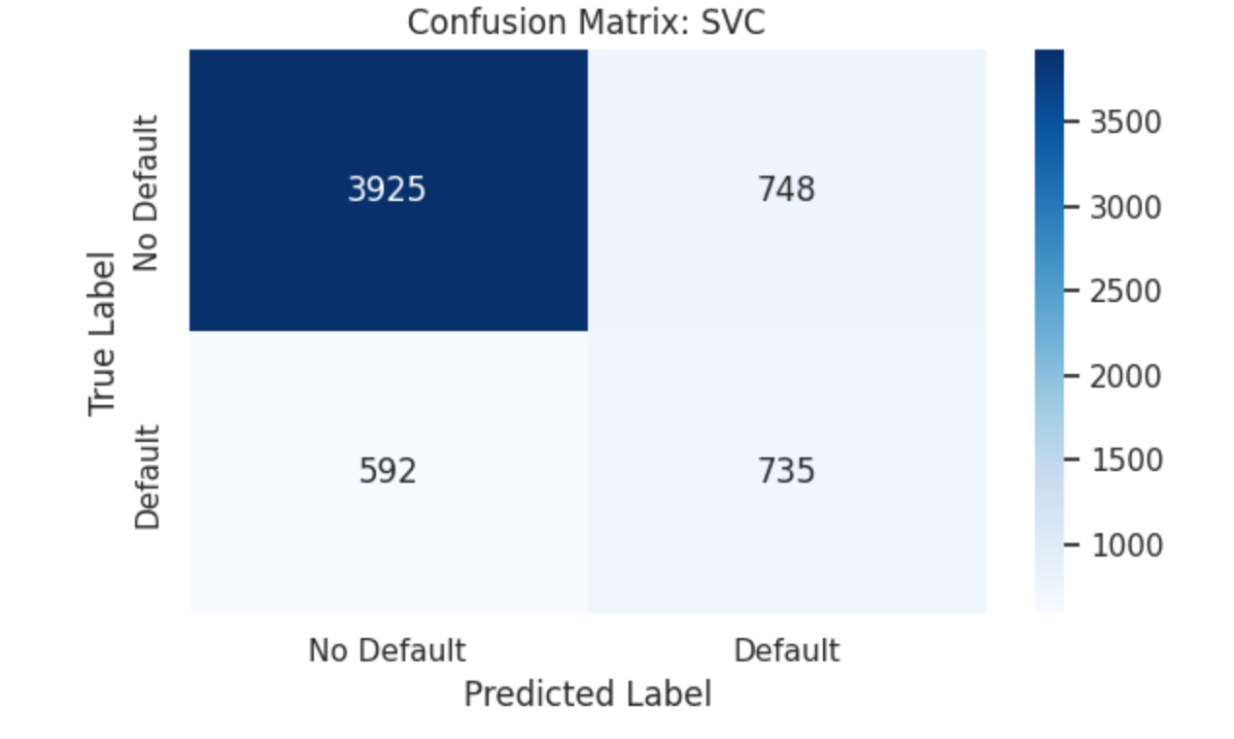
SVC(HyperTuned Model)

Slide 24
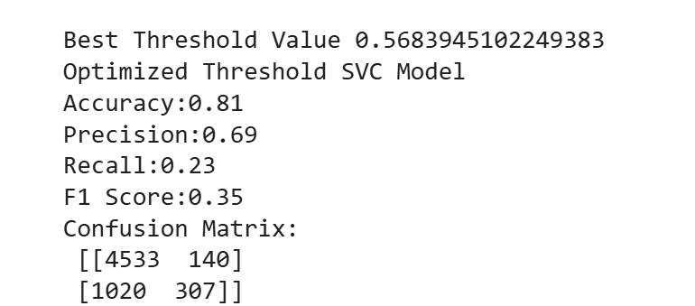
SVC(Best Threshold)

Slide 25
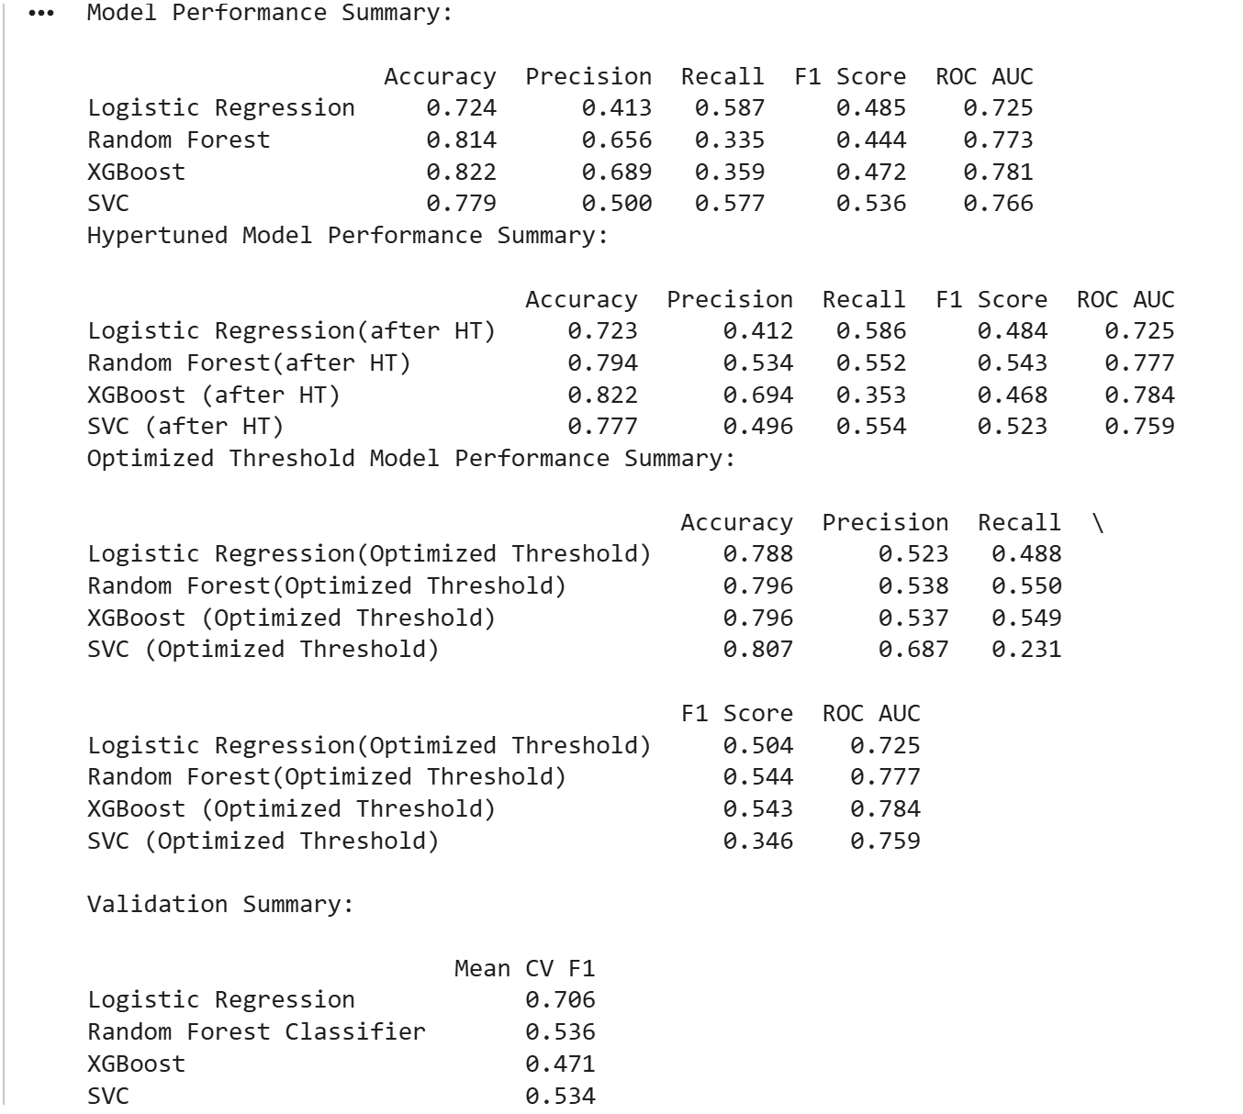
Model Performance Summary

Slide 26
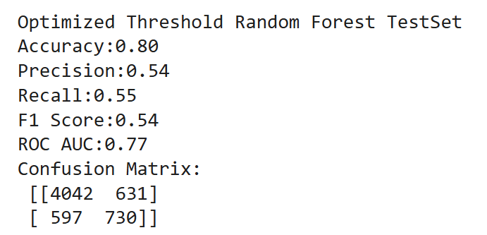
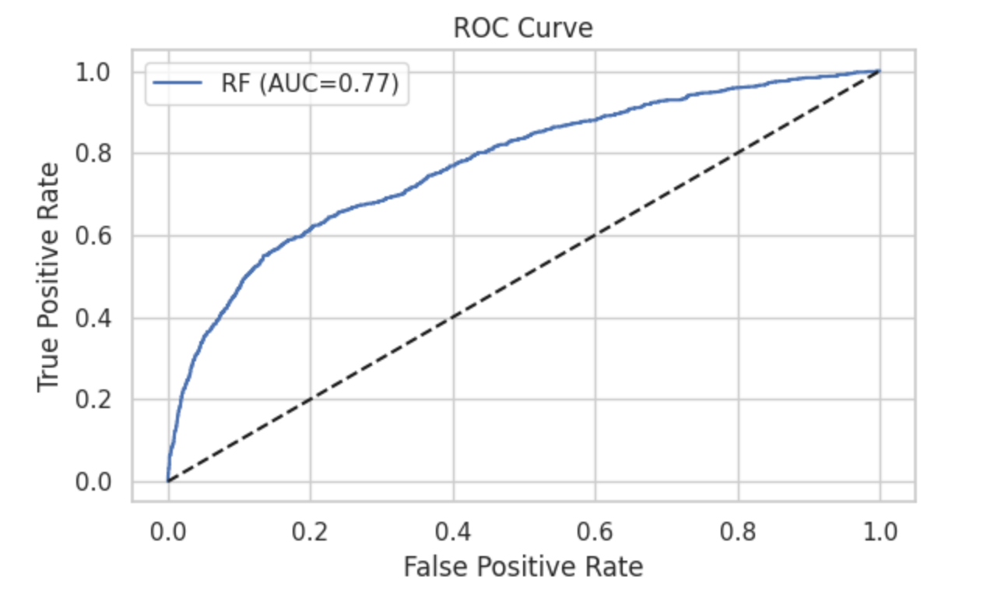
Implementing the Best Model on the Test set - RFC(Optimized Threshold)

Slide 27
Conclusion
Key Learnings:
1)Threshold Optimization is essential for imbalanced datasets.Optimizing threshold(0.5) for Random Forest and XGBOOST significantly improve their recall and F1 scores.
2)Other Metrics like F1 Score,Recall , Precision,ROC AUC should be taken for imbalance data sets other than accuracy.
3)Cross Validation reveals true model stability. Though Logistic Regression has the highest CV (0.7) it lacked in the other metrics. XGBOOST has the lowest CV score 0.4 showing it is more sensitive to data splits. Random Forest showed strong performance.
4)Ensemble models like XGBOOST and Random Forest showed better performance than the other 2 models.
5)Confusion Matrix Importance should be given to False positives and False negatives for this imbalanced dataset than accuracy.

Slide 28
Highlights:
1)EDA has been done on the data set and found that the class is imbalanced.So, SMOTE and class weight='balanced' techniques were used.
2)Data preprocessing and scaling were done on the numerical and categorical columns.
3)Evaluated models across Baseline,Hyperparameter Tuning , Optimized threshold and Cross Validation.
4)Best Overall Model: Random Forest(Optimized Threshold) Random Forest(Optimized Threshold) 0.796(accuracy),0.538(precision), 0.550(recall),0.544 (F1 SCORE) and ROC AUC (0.777)
5)Random Forest Classifier(Optimized Threshold) was applied on the test set and the below metric were calculated.
Optimized Threshold Random Forest TestSet Accuracy:0.80 Precision:0.54 Recall:0.55 F1 Score:0.54 ROC AUC:0.77 Confusion Matrix: [[4042 631] [ 597 730]]
6)Out of 6000 samples in the testset, we can see that 4772 samples have been predicted accurately.

Slide 29
Things to Improve
1)Feature Engineering - Model performance can be improved by adding more features,domain specific variables
2)Advanced Ensemble methods like LightBOOST and also other models like knn can be implemented.
3)Have to address False negatives since this is very expensive.This can be done using cost sensitive learning.
4)For improving code usability,Pipeline models can be used.

Slide 30
References
https://seaborn.pydata.org/generated/seaborn.kdeplot.html
https://www.geeksforgeeks.org/python/detecting-multicollinearity-with-vif-python/
https://www.geeksforgeeks.org/maths/chi-square-test/
https://github.com/HillidatulIlmi/EDA-and-Machine-Learning-Default-of-Credit-Card-Clients/blob/main/EDA_and_Machine_Learning_Default_of_Credit_Card_Clients.ipynb

Slide 31
Github Link
MS-AI/Pathway Machine Learning: Theory & Hands-On Practice with Python Specialization/CSCA 5622: Introduction to Machine Learning: Supervised Learning /Module 7 - Final Project at main · kmadhu181090/MS-AI

Slide 32
THANK YOU

